Slide 1
Stacco: Differentially Analyzing Side-Channel Traces for Detecting SSL/TLS Vulnerabilities in Secure Enclaves
Y. Xiao, M. Li, S. Chen, Y. Zhang
Yuan Xiao, Mengyuan Li, Sanchuan Chen, Yinqian Zhang
The Ohio State University

Slide 2
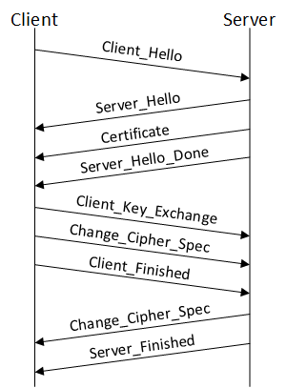
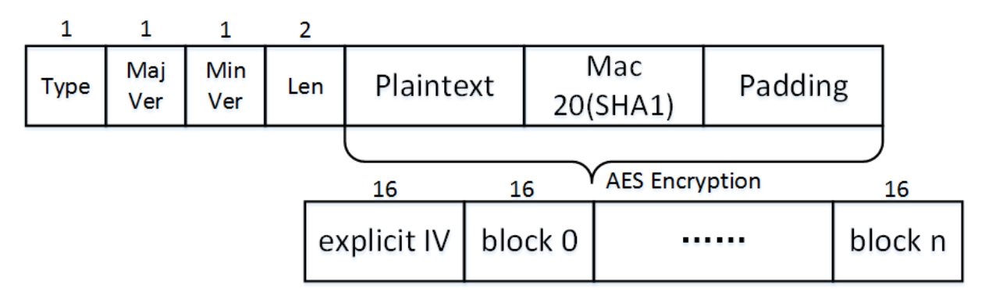
Y. Xiao, M. Li, S. Chen, Y. Zhang
SSL/TLS
A general purpose security protocol
Transparently protect the confidentiality and integrity of network communications on top of TCP layer
TLS handshake
TLS data record (w/ AES-SHA1-CBC)

Slide 3
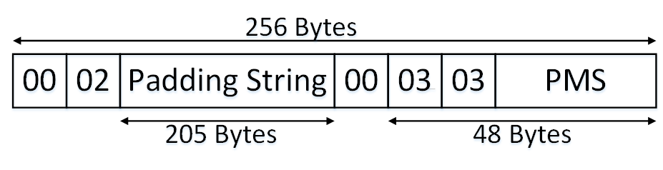

Y. Xiao, M. Li, S. Chen, Y. Zhang
SSL/TLS
ClientKeyExchange: encrypts padded PreMasterSecret (PMS) w/ server’s public key
PMS: used by the server to generate MasterSecret for the TLS connection
Plaintext of ClientKeyExchange message (w/ 2048-bit RSA keys)
TLS handshake

Slide 4
Y. Xiao, M. Li, S. Chen, Y. Zhang
Bleichenbacher Attack
Adaptive chosen-ciphertext attack against RSA (PKCS#1 v1.5): A correctly formatted ClientKeyExchange (CKE) plaintext m must begin with 0x0002.
=> 2B ≤ m < 3B, B = 0x00010…0
8(L − 2) zeros
Oracle: returns TRUE only when the plaintext of a chosen ciphertext begins with 0x0002

Slide 5
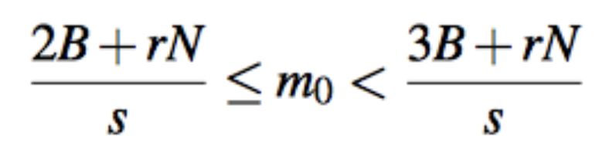
Y. Xiao, M. Li, S. Chen, Y. Zhang
Bleichenbacher Attack
2B ≤ m < 3B, B = 0x00010…0
8(L − 2) zeros
Let c=(c₀·s^{e}) mod N=(m₀·s)^{e} mod N, where c₀ and m₀ are the original ciphertext and its corresponding plaintext to decipher
Query with multiple s values to narrow down m₀

Slide 6
Y. Xiao, M. Li, S. Chen, Y. Zhang
Bleichenbacher Attack Workflow
ClientHello
ServerHello
Attacker
Certificate
ServerHelloDone
ClientKeyExchange
ClientFinished
ServerFinished

Slide 7
Y. Xiao, M. Li, S. Chen, Y. Zhang
Bleichenbacher Attack Workflow (Con’t)
ClientHello
ServerHelloDone
C’
Attacker
ServerHelloDone
ServerHelloDone
ClientKeyExchange
New C’
ClientFinished
ServerHelloDone
Alert
Oracle?
True/False

Slide 8
Y. Xiao, M. Li, S. Chen, Y. Zhang
Bleichenbacher Attack History
 | Oracle | Mitigation
Original Attack | Different alert messages for different error types | Single alert message
Timing Attack | Timing side-channel (JSSE only) | Constant-time code patch
Drown Attack | Weak cipher leaking partial plaintext (w/ SSL 2.0) | No shared key & cert on SSL 2.0 servers

Slide 9
Y. Xiao, M. Li, S. Chen, Y. Zhang
Overview
Trusted execution environment (eg. Intel SGX) brings new problems to SSL/TLS implementations
Stacco tool framework: differential analysis for chosen-ciphertext oracles from side-channels
Tests: detect both Bleichenbacher oracles and CBC padding oracles in five popular TLS libraries

Slide 10
Y. Xiao, M. Li, S. Chen, Y. Zhang
Intel SGX: New Threat Model
Process
Process
Process
Intel SGX:
Protect applications against malicious OS
Confidentiality and integrity, of code and data
Memory isolation and encryption
Secret
Enclave
Untrusted Components
…
OS
Man-in-the-kernel attacker

Slide 11
Y. Xiao, M. Li, S. Chen, Y. Zhang
Control-Flow Inference Attacks
Branch-level
attacks
enclave
EPC pages
Control flow related to sensitive input
Monitor control flow => infer secrets
CFG
Cacheline-level
attacks

Slide 12
Y. Xiao, M. Li, S. Chen, Y. Zhang
Page-level Side-Channel Attacks
Virtual address
PGD offset | PUD offset | PMD offset | PTE offset | Page offset
Page Fault Handler
(Kernel)
CR3
pgd_t
pud_t
Access
pmd_t
pte_t
PGD
Page Fault
PUD
PMD
PT
Page
Page Table Entry
63
62
52
51
12
11
9
0
XD
Physical Page Address
G
0
D
A
C
W
U
R
P

Slide 13
Y. Xiao, M. Li, S. Chen, Y. Zhang
Page-level Side-Channel Attacks
dummy (secret):
for each bit in secret:
if (bit == 0):
func_a (bit);
else
func_b (bit);
Page 1
Page 2
Page 3
dummy
func_b
func_a
Page sequence: P1, P2, P1, P3, P1, P3, P1, P2…
Infer secret: 0, 1, 1, 0…

Slide 14
Attacks

Slide 15
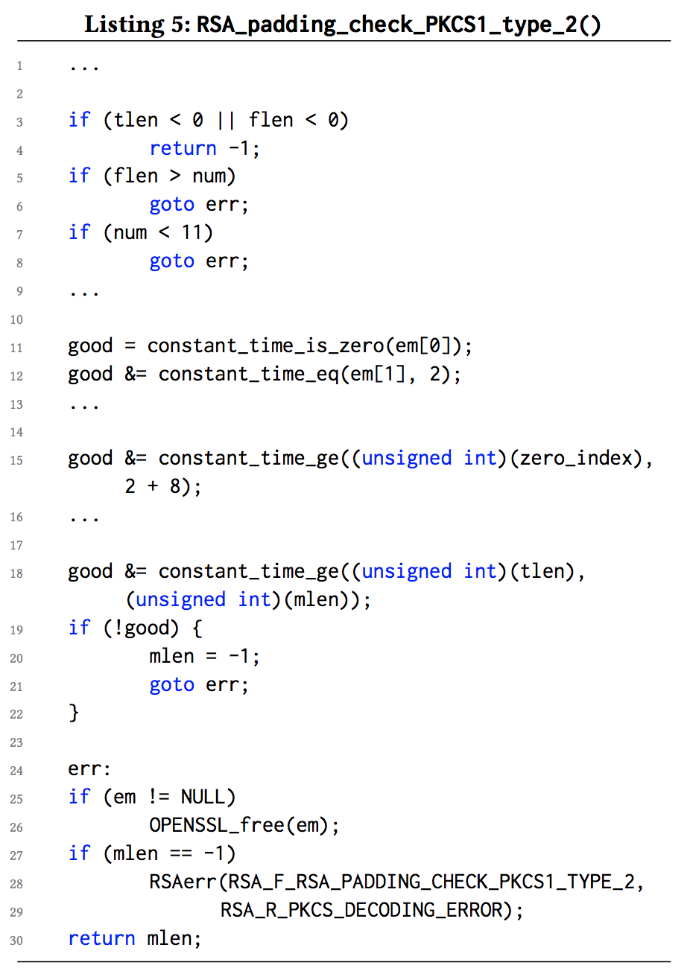
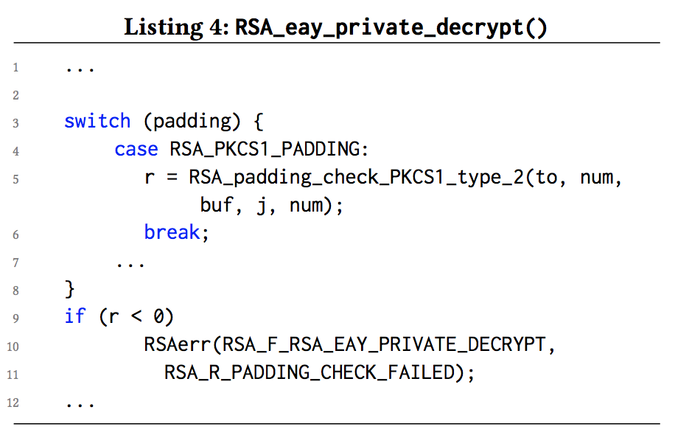
Y. Xiao, M. Li, S. Chen, Y. Zhang
Demo Vulnerability
Page 1
Page 2
RSAerr
calls
RSA_padding_check…
Page sequence: P2, P1, P2, P1 => wrong format
Page sequence: P2 => correct format
Bleichenbacher vulnerability in OpenSSL 1.0.2j (Feb 2017)

Slide 16
Y. Xiao, M. Li, S. Chen, Y. Zhang
Attack Settings
enclave
Replace CKE
TLS Library
Client
handshake
Server
Oracle
user space
kernel space
Attacker Module
page sequence
Page Fault Handler

Slide 17
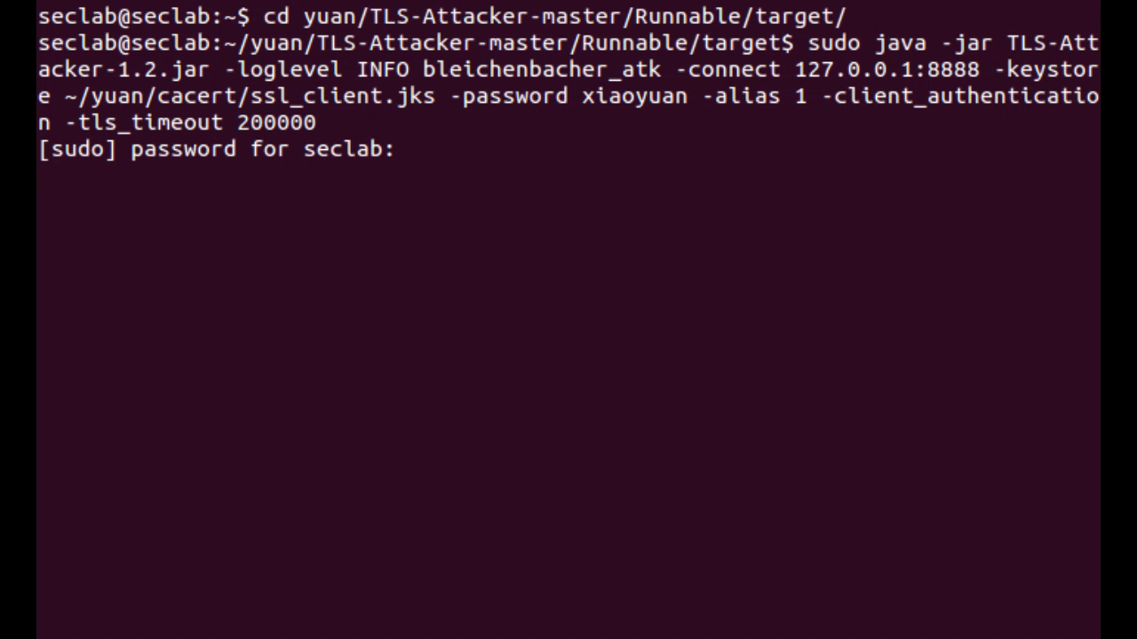
Y. Xiao, M. Li, S. Chen, Y. Zhang
Demo
(00)
PMS (after 0x0303)

Slide 18
Y. Xiao, M. Li, S. Chen, Y. Zhang
Performance
Length | 1024 | 2048 | 4096
Inquiries | 19,346 | 19,368 | 57,286
Time | 28m20s | 33m24s | 1h31m39s
History: at least 20 hours* (already fixed)
Typical TLS session
session end
History attacks
online hijack
offline attack
Our attacks
* Christopher Meyer, Juraj Somorovsky, Eugen Weiss, Jörg Schwenk, Sebastian Schinzel, and Erik Tews. 2014. Revisiting SSL/TLS implementations: New Bleichenbacher side channels and attacks. In 23rd USENIX Security Symposium (USENIX Security 14). 733–748.

Slide 19
Y. Xiao, M. Li, S. Chen, Y. Zhang
Other Attacks
Chosen Ciphertext Attacks
Drown Attack
Timing-based Attack
…
Lucky 13 Attack
POODLE Attack
…
Bleichenbacher Attacks
Padding Oracle Attacks

Slide 20
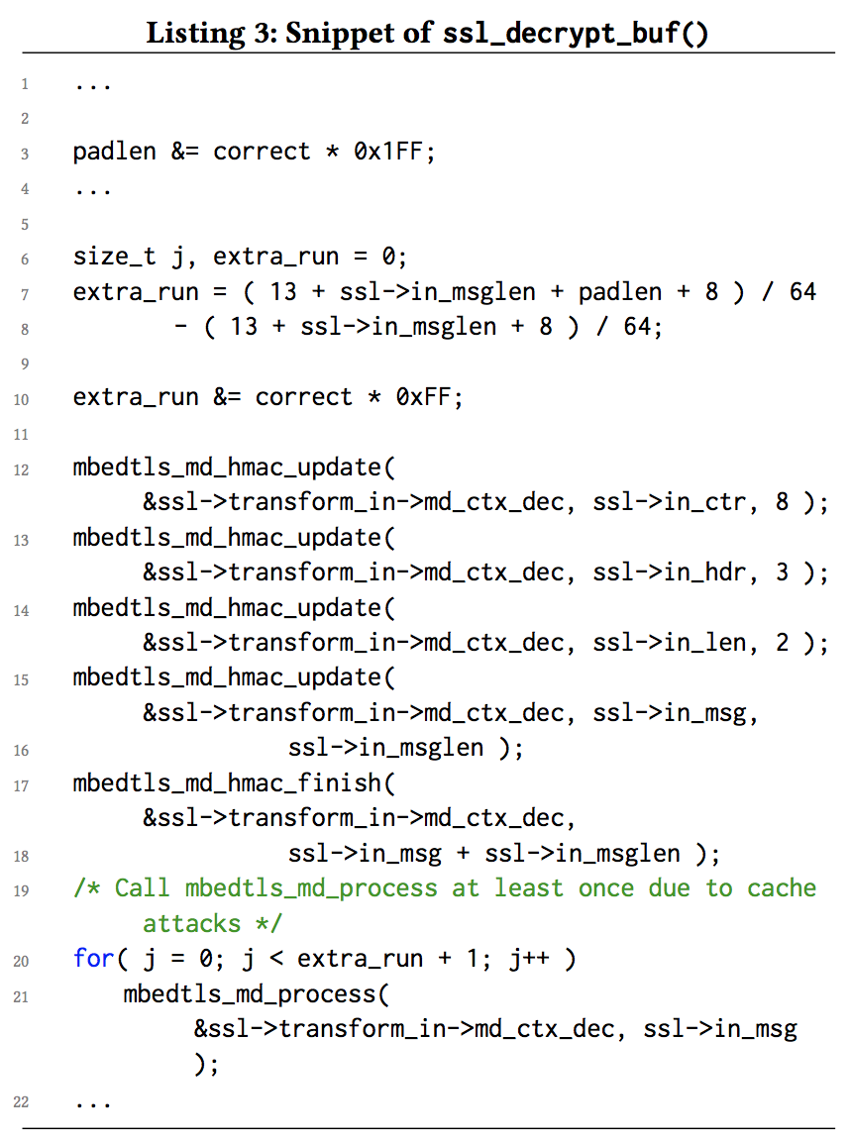
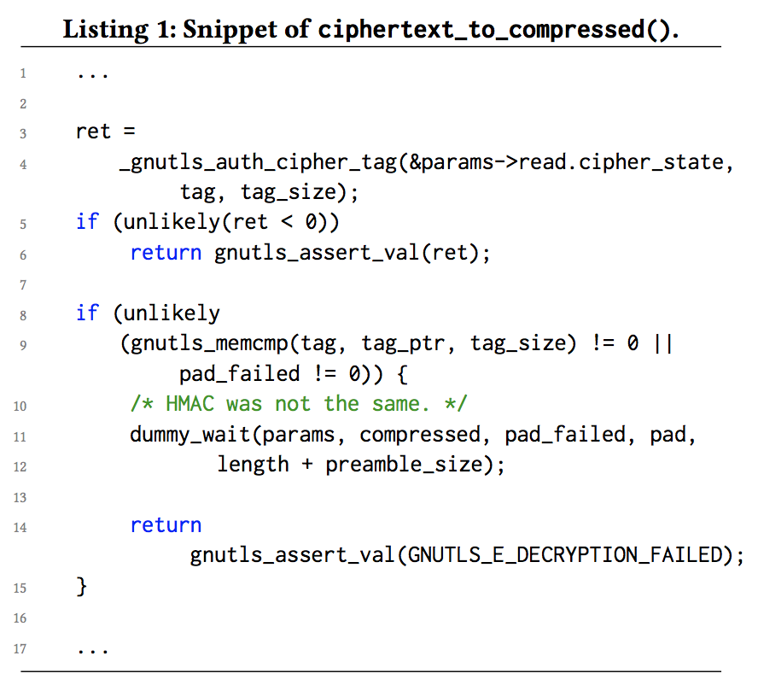
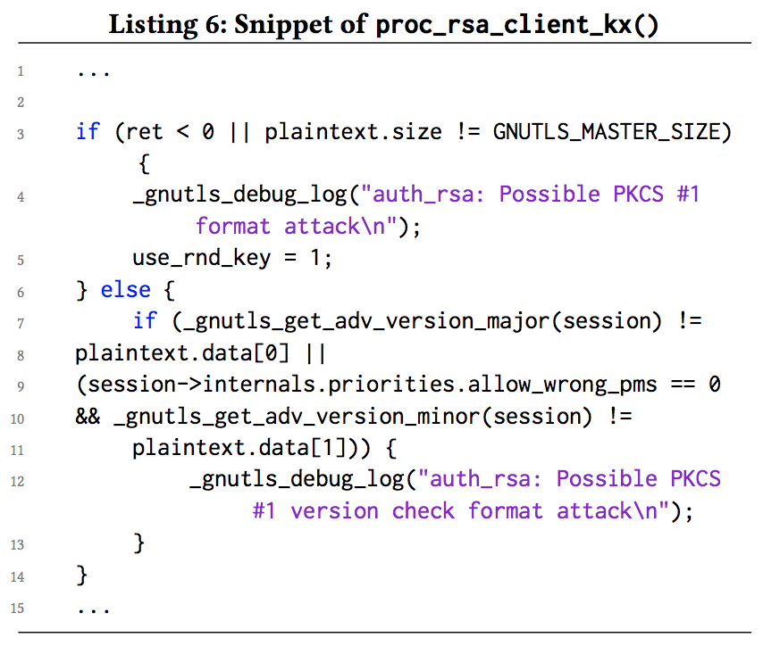
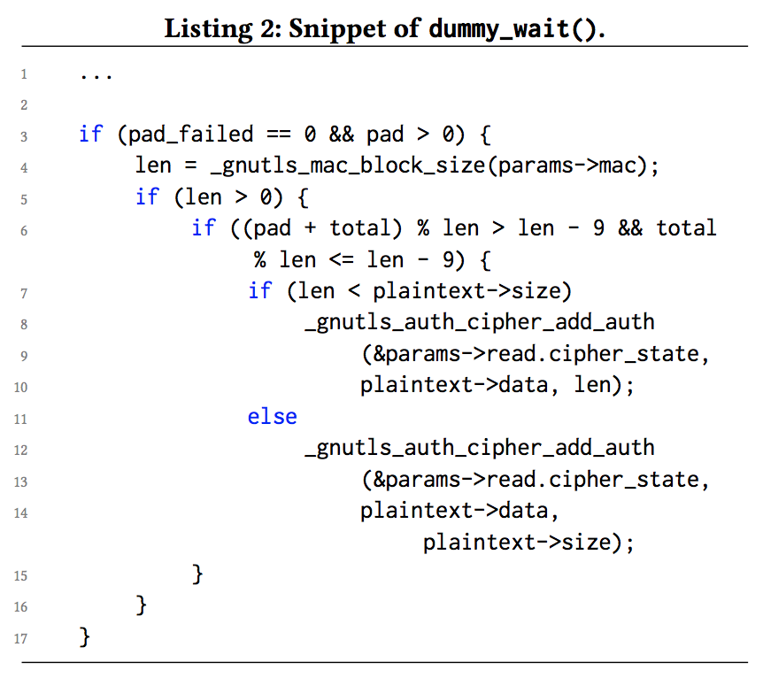
Y. Xiao, M. Li, S. Chen, Y. Zhang
Sensitive Control-Flow Vulnerabilities
1
calls
calls
CBC padding oracle - mbedTLS
And more…
3
2
Bleichenbacher - GnuTLS
4
Bleichenbacher - OpenSSL
CBC padding oracle - GnuTLS

Slide 21
Stacco Framework

Slide 22
Y. Xiao, M. Li, S. Chen, Y. Zhang
Framework Architecture
Stacco:
Side-channel Trace Analyzer for finding Chosen-Ciphertext Oracles

Slide 23
Y. Xiao, M. Li, S. Chen, Y. Zhang
Why Differential Analysis?
Packet 1
Error 1
Control flow 1
Different?
Packet 2
Error 2
Control flow 2
Different control flows leak information of plaintext (types of error)
Also allows scalable analysis of libraries; no need of source code

Slide 24
Y. Xiao, M. Li, S. Chen, Y. Zhang
Differential Analysis
BB 1
BB 2
BB 3
BB 5
…
Basic Block Diff Result
Vulnerabilities
Branch level
Packet w/ error 1
In-library Virtual Address
BB 1
BB 2
BB 4
BB 5
…
Cacheline level
Cacheline size: 64 B (2^6)
6
5
0
Page level
Packet w/ error 2
Page size: 4096 B (2^12)
12
11
0

Slide 25
Y. Xiao, M. Li, S. Chen, Y. Zhang
Error Type Choice
Plaintext of ClientKeyExchange message (2048-bit RSA keys)
01
03
Random
Standard error: NOT beginning with 0x0002
00
01
02
Random
Error 3: No 0x00 byte
Error 4: Wrong SSL version number
Error 1: wrong PMS (correct format)
Error 2: 0x00 byte in padding

Slide 26
Y. Xiao, M. Li, S. Chen, Y. Zhang
Error Type Choice
0 | NOT beginning with 0x0002
1 | Invalid PMS (correct format)
2 | Wrong Version
3 | No 0x00 Byte
4 | 0x00 in Padding
5 | 0x00 in PKCS Padding
6 | PMS Size=0
7 | PMS Size=2
8 | PMS Size=8
9 | PMS Size=32
Diff between 0 & 4
Diff between 0 & 1
Diff between 0 & 3
Diff between 0 & 2
Diff between 0 & n (n = 1 … 9)
…

Slide 27
Tests and Results
Notes:
After the introductions, now let’s look at the tests and their results.

Slide 28
Y. Xiao, M. Li, S. Chen, Y. Zhang
Test Design
Test Object: SSL/TLS libraries
Use Stacco to look for Bleichenbacher vulnerabilities and CBC padding oracle vulnerabilities
Output:
Whether a library is vulnerable
How severe the vulnerabilities are
Where the vulnerabilities are

Slide 29
Y. Xiao, M. Li, S. Chen, Y. Zhang
Test Results
: Vulnerable
: Not vulnerable
: Unable to test
B: Branch level
C: Cacheline level
P: Page level
 | OpenSSL 1.0.2j |  |  | GnuTLS 3.4.17 |  |  | mbedTLS 2.4.1 |  |  | WolfSSL 3.10.0 |  |  | LibreSSL 2.5.0
 | B | C | P | B | C | P | B | C | P | B | C | P | B | C | P
Bleichen-bacher Attacks
CBC Padding Oracle Attacks
All libraries were the latest version when tested (February 2017)

Slide 30
Y. Xiao, M. Li, S. Chen, Y. Zhang
Test Results
All tested SSL/TLS libraries are vulnerable to both attacks. We have reported these vulnerabilities to Intel, OpenSSL, GnuTLS, and mbedTLS.
Vulnerabilities are caused by improper error logging and reporting or by the patches for existing side-channel attacks.

Slide 31
Y. Xiao, M. Li, S. Chen, Y. Zhang
Error Logging/Reporting
Common in Bleichenbacher vulnerabilities
Extra error logging and reporting functions specific for PKCS#1 format errors
Bleichenbacher - GnuTLS
Bleichenbacher - OpenSSL

Slide 32
Y. Xiao, M. Li, S. Chen, Y. Zhang
Improper Patches
Common in CBC padding oracle vulnerabilities
Constant-time patches for Lucky 13 attacks
CBC padding oracle - mbedTLS
Improper implementation: extra fake function calls
CBC padding oracle - GnuTLS

Slide 33
Discussions

Slide 34
Y. Xiao, M. Li, S. Chen, Y. Zhang
Countermeasure
Preventing control-flow inference attacks.
Patching sensitive control-flow vulnerabilities
Avoiding using the vulnerable ciphersuites.
Stacco itself provides developers with a practical way to prevent the threat by finding and fixing vulnerabilities in a scalable manner.

Slide 35
Y. Xiao, M. Li, S. Chen, Y. Zhang
Conclusion
New insights: the challenge of securely implementing TLS inside SGX enclaves is more severe than thought.
New methods: differentially analyzing binary code to detect vulnerabilities for oracle attacks is a new attempt.
New tools: Stacco toolchain to link multiple components, and the analysis tools will be released to the community.

